Slide 1
Remove this slide prior to presentation externally
Required Regulatory Reviews -Approvals are needed if you choose to modify this promotional material
Review your modified material(s) with the appropriate Claims Coordinator for a) the truth and accuracy of all claims, b) whether the substantiation provided is sufficient to support each claim [If you used already-approved claims from the WH Fact Library, this step is not required], and c) alignment with Watson Health brand guidelines.
Following above, you and your Coordinator will submit the Watson Health Claims Coordinator Certification Form <URL> with your material(s) to the Watson Health QMS Marketing & Communications Legal Community (“WH QMS Community”)The review teams (Marketing & Communications Legal, and QMS if applicable) will return consolidated, reconciled legal comments for you to review and address.
After updating your material(s) in accordance with the feedback provided, resubmit it to your original entry in the WH QMS Community to obtain final approval of your material(s) .
Visit the WH QMS Community for more on:
The review process
Types of material and content requiring review
The WH Claims Coordinator Certification Form
The libraries of pre-approved facts, and photography permitted for use
List of Legal Contacts
Thank you for your compliance and dedication to the success of our business!
Nadine Noreldin, Esq. Marketing Operations & Compliance Leader nnoreldin@us.ibm.com | 508-545-4578

Slide 2
IBM Watson Health, Clinical Decision Support
IBM Micromedex® With Watson™ Putting the power of AI to work for you.

Slide 3
Challenges with delivering effective care
By 2020
medical data is expected to double every 73 days³
45% of medicine is not evidence based¹
29 hours
Approximate amount of time Doctors would have to read each workday to keep up with new professional insights²
½ of the workday
Primary care physicians spend nearly
6 hours interacting with the EHR
during and after clinic hours⁴
Sources:
1) http://www.nejm.org/doi/full/10.1056/NEJMsa022615#t=abstract
2) J Med Libr Assoc. 2004 Oct; 92(4): 429–437. How much effort is needed to keep up with the literature relevant for primary care? Available at: http://www.ncbi.nlm.nih.gov/pmc/articles/PMC521514
3) https://www-03.ibm.com/press/us/en/photo/46588.wss
4. Tethered to the EHR: Primary Care Physician Work- load Assessment Using EHR Event Log Data and Time- Motion Observations

Slide 4

IBM Micromedex®
Designed to help you make informed clinical decisions
Evidence-based knowledge to enable the most appropriate treatment decisions anytime, anywhere
Options to help you standardize patient care across your organization with access to evidence-based guidelines and protocols
Information on drug use and approvals from international sources so you can independently assess the information to make informed treatment decisions
Notes:
Script (Arti):
Establish Script
Notes:
Use for customer-facing presentations.
Image and layout from the IBM Watson Health VBC deck

Slide 5
IBM Micromedex®
Evidence-based clinical decision support for informed, confident decisions
Used by over 4,500 hospitals in 80+ countries
Used by governments and hospitals for 40+ years
Used in schools of pharmacy and academic centers internationally
Supports toxicology management in poison control centers around the world
CMS-named compendia since 2008
Content created and maintained using a NICE accredited editorial process
Contains in-depth information that clinicians may need for complicated cases
Quick access to evidence with the AI of Watson
Notes:
Notes:
Use for customer-facing presentations.
Image and layout from the IBM Watson Health VBC deck
Facts are current as of 5/Oct, 2017 and approved

Slide 6
Watson Health © IBM Corporation 2018
Our strengths
1
Comprehensive evidence
2
Efficient and easy to use
3
Reliable service and support
Notes:
Script (Petra)
In the face of competitive pressure, we look to our strengths to differentiate.
For decades, Micromedex has been recognized across the healthcare industry as having comprehensive, evidence-based content covering medication, disease and toxicology management and accompanying patient education materials. We meet the information needs for a broad spectrum of clinical users as well as their patients across the continuum of care.
Our solutions are available when and where clinicians need information. We’ve made significant strides in improving the ease of use and will continue this through the integration of cognitive capabilities that will transform how clinicians find answers.
Our dedicated client services organization supports our clients at every step, from streamlined implementations, comprehensive training resources, and world-class customer support, we forge strong relationships to ensure client success.

Slide 7

Our clinical review process makes it possible
Highly trained staff
Clinical evidence identified
Content created
Decision support delivered
Clinicians
Health Literacy Experts
Medical Librarians
8,500 journals
15,000 medical articles
25,000 high-level reviews
400 in-depth reviews
Objectively validated
Evidence-based
Notes:
Our process and our people are our advantage when it comes to creating comprehensive content. An in-house staff of experts work within a robust set of editorial standards to identify relevant evidence, critically evaluate it to select the best available evidence on a given topic and synthesize it into clinically consistent content that supports decisions at the point of care across a wide variety of practice settings and specialties. Our processes are recognized internationally as being stringent and robust and leading to objective, evidence-based content as indicated by our compendium designation by CMS to support off-label coverage and processes accredited by the UK’s National Institute of Health and Care Excellence.

Slide 8
Offerings, core solutions
Medication Management
Toxicology Management
Disease Management
Patient and Consumer Education
Notes:
Script (Arti):
Establish Script
We have 4 primary offerings
For each screen shot – tie to driver and user group, value derived, verbal use case, differentiate to win….tie it in.
Stats/Proof Points:
Used by over 4,500 hospitals worldwide, 80 countries
Used in accredited schools of pharmacy and academic centers worldwide
Medication Management
Comprehensive Drug Information
Pediatric and Neonatal Evidence
Drug Interactions
IV Compatibility
Alternative Medicine
Formulary Management
Global drug information
Disease and Condition Management
Acute and chronic disease info
Emergency and general medicine
Procedure and treatment info
Protocol checklists
Lab recommendations
Toxicology Management
Drug Overdose and toxicity
Comprehensive management for potential poison sources of household products, plants and chemicals.
Data on reproductive risks, including effects of drugs, chemicals, and environmental agents
Database for management of chemicals and hazardous spills

Slide 9
Offerings, core solutions
Medication Management
– Comprehensive Drug Information – Pediatric and Neonatal Evidence – Drug Interactions – IV Compatibility – Alternative Medicine – Formulary Management – Global drug information

Slide 10
Offerings, core solutions
Toxicology Management
– Drug Overdose and toxicity – Comprehensive management for household
products, plants and chemicals – Data on reproductive risks – Database for management of chemicals and
hazardous spills

Slide 11
Offerings, core solutions
Disease Management
– Acute and chronic disease info – Emergency and general medicine – Procedure and treatment info – Protocol checklists, based on public,
peer reviewed guidelines – Lab recommendations

Slide 12
Offerings, core solutions
Patient and Consumer Education
– 13,600 education titles that can be integrated into any EMR – 2,400 easy-to-read medication handouts – 54 animations for children covering common conditions – Online health library and videos
Note: Supplementary offerings for CPOE medication advisory screening, drug pricing, and partnership with BD for surveillance with MedMined

Slide 13
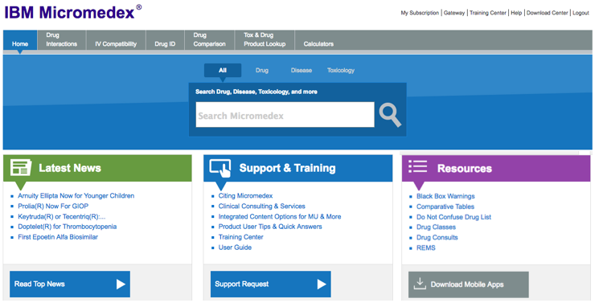
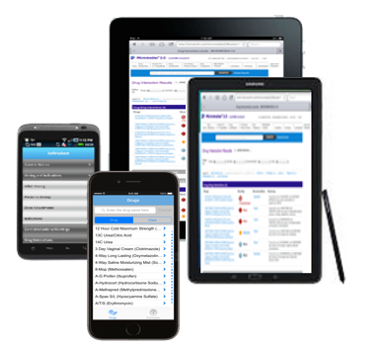
Delivery methods
Micromedex can be delivered
in various formats:
>Computer
>Mobile Phone
>Tablet
Online
Partner EHRs and portals
Mobile

Slide 14
From the front lines
“We feel completely confident that the information [in IBM Micromedex] ... is accurate and up to date.” Director (KLAS, January 2017)
“Micromedex Medication Management has a section with in-depth answers, so [users have] access to very quick answers. The system's answers either help with the difficult case or help me make a more confident decision.” Manager/Analyst (KLAS, February 2017)
“I know the information in Micromedex is reliable, and I can get to it quickly.” Clinical pharmacist, ICU, 200-bed hospital
Notes:
Script (Arti):
Establish Script

Slide 15
Conversational Search: IBM Micromedex with the artificial intelligence of Watson

Slide 16

Humans + Cognitive = AI or Augmented Intelligence
People excel at:
Common sense
Dilemmas
Morals
Compassion
Imagination
Dreaming
Abstraction
Generalization
Cognitive systems excel at:
Natural Language
Pattern Identification
Locating Knowledge
Machine Learning
Minimize Bias
Endless Capacity
Notes:
Speak to how cognitive systems will Augment the way we work to help us accomplish more by actualizing technology advancements
Cognitive Systems help with:
Pattern identification, to assist with precision medicine, drug interactions, ADE’s etc.
Locating specific knowledge, within a vast database or evidence resource which is becoming more difficult with ever increasing information
Have a unique capability of Machine Learning, the more it’s used the better the systems will become at answering more sophisticated questions
Humans excel in different ways:
So your job as a clinician will evolve with this technology but not be replaced. The goal for cognitive computing is to help humans accomplish more thru enabling technology… only skilled clinicians will be able to determine the most appropriate individualized needs for patients.

Slide 17

Your knowledge, accelerated.
IBM Micromedex® with Watson™
As roles evolve, today’s pharmacists need more from evidence-based clinical resources than ever before.
That's why we’re combining AI with Micromedex, to transform how you find answers and help you accelerate care.
Notes:
As new drug, patient and population information accumulates and your roles continue to evolve today’s pharmacists need more from evidence-based medicine resources than ever before.
That's why we’re combining cognitive computing with Micromedex, to transform how you find answers and help you accelerate care.

Slide 18
The Micromedex difference, putting the power of AI to work for you
IBM Micromedex® with Watson™
1
2
Designed for you
Trained by clinicians
Developed with the evidence of Micromedex. Regularly validated by IBM clinicians to answer more questions from an expanding source of evidence.
Provides more flexibility to type questions in a more natural and conversational way, for clear and concise answers.
3
Relied upon evidence
4
Easily accessible
Accelerate your access to the evidence-based information you count on IBM Micromedex for.
Multiple delivery methods for online work from Micromedex or from within the EHR, help leap system constraints and deliver reliable access.
Watson Health © IBM Corporation 2019
Notes:
2- train tune cycle

Slide 19
Using Micromedex with Watson
Epinephrine
Adult Dosing
For cardiopulmonary resuscitation
Initial, 1 mg IV/intraosseously. May be repeated as necessary every 3 to 5 minutes (guideline dosage) [10]
Initial, 2 to 2.5 mg endotracheally if IV/intraosseous access is delayed or cannot be established (guideline dosage) [10]
medication
Your questions help Watson understand natural language and return the most relevant evidence.
patient age
Use / Indication
Dosing 1
Dosing 2
What’s the adult dosing of epinephrine for cardiopulmonary resuscitation?
19

Slide 20
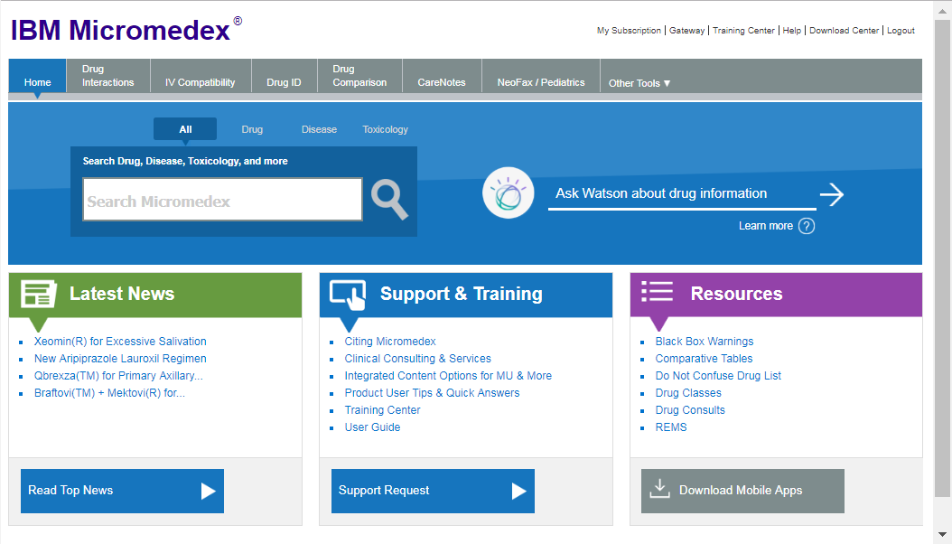
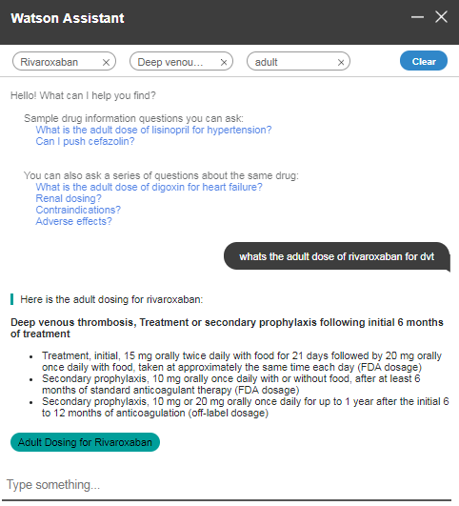
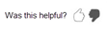
Conversational search
IBM Micromedex® With Watson™ incorporates the AI-powered Watson Assistant into its medication-management "Quick Answers" content to transform how you find answers and help you accelerate your decisions.
Clear information about what questions can be answered
Ask a series of contextual questions with smart filtering
Clinically actionable answers
How does it work?
You can tap the AI-powered search technology directly from Micromedex by activating the conversational search assistant "Ask Watson," or by using a traditional search approach.
Links to relevant evidence
Tools to collect on-going feedback
Notes:
How do I access Conversational Search?
http://certify.micromedexsolutions.com/micromedex2/librarian/
Username: tjwatson
Password: cognitivemdx
Script:
We are excited to share the latest enhancement to IBM Micromedex that really sets us apart in the industry, Micromedex with Watson. We have incorporated a component of artificial intelligence into Micromedex. Artificial Intelligence incorporates human like intelligence into computer systems to improve the user experience and help us all get more work done. Natural Language Processing is an application of AI that enables YOU to ask questions more naturally and enables THE COMPUTER to respond and deliver more relevant information. With Watson Assistant, you can put the power of AI to work by simply asking questions, like clinicians ask clinicians. Then you’ll receive the answers you need from the evidence you have always trusted in Micromedex.
Clinicians from around the world have helped train Watson and our first step with Conversational Search delivers summary drug information from the Quick Answer content in Micromedex. Watson has learned how clinicians ask questions, understands the difference between medications and conditions, and can infer reasoning from the variety of ways questions may be asked. That’s the power of AI.
When you open Micromedex you see all the great tools you expect are still available but there’s something new. That’s Watson Assistant. To begin a conversation, you begin typing on the conversation line or select the Watson symbol. We have also included a learn more link to help you understand what questions you can ask Watson, what content Watson currently understands, what it doesn’t understand. As we continue to train Watson this content will be updated.
So let’s start a conversation with Watson…..

Slide 21
And we’re just getting started …
Contact us at
micromedex@us.ibm.com
to find out more
Notes:
With Watson you can.
Speaker to select two or three examples from the chart to illustrate Watson capabilities.
Enrich interactions: Autodesk
Detect liabilities: Cog Security
Scale expertise: Woodside

Slide 22
Legal Disclaimer
© IBM Corporation 2019. All Rights Reserved.
The information contained in this publication is provided for informational purposes only. While efforts were made to verify the completeness and accuracy of the information contained in this publication, it is provided AS IS without warranty of any kind, express or implied. In addition, this information is based on IBM’s current product plans and strategy, which are subject to change by IBM without notice. IBM shall not be responsible for any damages arising out of the use of, or otherwise related to, this publication or any other materials. Nothing contained in this publication is intended to, nor shall have the effect of, creating any warranties or representations from IBM or its suppliers or licensors, or altering the terms and conditions of the applicable license agreement governing the use of IBM software.
References in this presentation to IBM products, programs, or services do not imply that they will be available in all countries in which IBM operates. Product release dates and/or capabilities referenced in this presentation may change at any time at IBM’s sole discretion based on market opportunities or other factors, and are not intended to be a commitment to future product or feature availability in any way. Nothing contained in these materials is intended to, nor shall have the effect of, stating or implying that any activities undertaken by you will result in any specific sales, revenue growth or other results.
Performance is based on measurements and projections using standard IBM benchmarks in a controlled environment. The actual throughput or performance that any user will experience will vary depending upon many factors, including considerations such as the amount of multiprogramming in the user's job stream, the I/O configuration, the storage configuration, and the workload processed. Therefore, no assurance can be given that an individual user will achieve results similar to those stated here.
All customer examples described are presented as illustrations of how those customers have used IBM products and the results they may have achieved. Actual environmental costs and performance characteristics may vary by customer.
IBM, the IBM logo, ibm.com, and Watson Health are trademarks of International Business Machines Corp., registered in many jurisdictions worldwide. Other product and service names might be trademarks of IBM or other companies. A current list of IBM trademarks is available on the Web at “Copyright and trademark information” at ibm.com/legal/copytrade.
Watson Health © IBM Corporation 2019

Slide 23
IBM's statements regarding its plans, directions and intent are subject to change or withdrawal without notice at IBM's sole discretion.
Information regarding potential future products is intended to outline our general product direction and it should not be relied on in making a purchasing decision.
The information mentioned regarding potential future products is not a commitment, promise, or legal obligation to deliver any material, code or functionality. Information about potential future products may not be incorporated into any contract. The development, release, and timing of any future features or functionality described for our products remains at our sole discretion.
Watson Health © IBM Corporation 2019

Slide 24
Forward Looking Statements
Certain statements contained in this presentation may constitute forward-looking statements within the meaning of the Private Securities Litigation Reform Act of 1995. Forward-looking statements are based on the company’s current assumptions regarding future business and financial performance. These statements involve a number of risks, uncertainties and other factors that could cause actual results to differ materially, including the following: a downturn in the economic environment and client spending budgets; the company’s failure to meet growth and productivity objectives; a failure of the company’s innovation initiatives; risks from investing in growth opportunities; failure of the company’s intellectual property portfolio to prevent competitive offerings and the failure of the company to obtain necessary licenses; cybersecurity and data privacy considerations; fluctuations in financial results; impact of local legal, economic, political and health conditions; adverse effects from environmental matters, tax matters and the company’s pension plans; ineffective internal controls; the company’s use of accounting estimates; the company’s ability to attract and retain key personnel and its reliance on critical skills; impacts of relationships with critical suppliers; product quality issues; impacts of business with government clients; currency fluctuations and customer financing risks; impact of changes in market liquidity conditions and customer credit risk on receivables; reliance on third party distribution channels and ecosystems; the company’s ability to successfully manage acquisitions, alliances and dispositions; risks from legal proceedings; risk factors related to IBM securities; and other risks, uncertainties and factors discussed in the company’s Form 10-Qs, Form 10-K and in the company’s other filings with the U.S. Securities and Exchange Commission (SEC) or in materials incorporated therein by reference. The company assumes no obligation to update or revise any forward-looking statements. These charts and the associated remarks and comments are integrally related, and are intended to be presented and understood together.
Watson Health © IBM Corporation 2019

